Slide 1
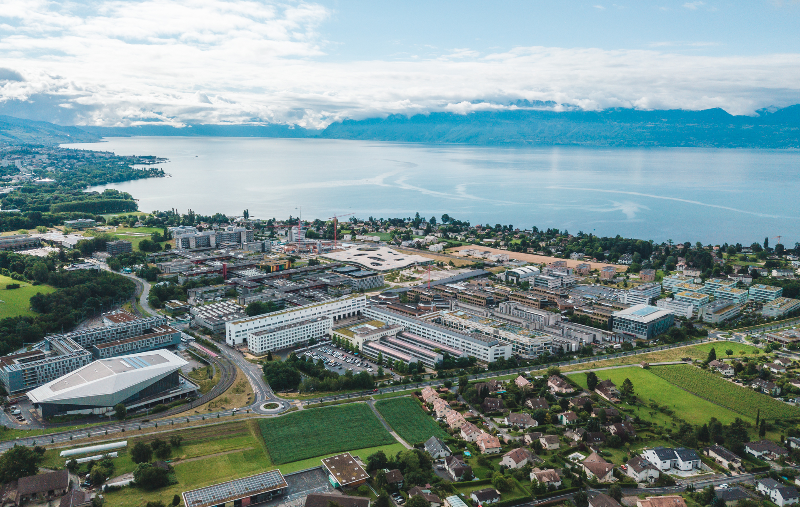
Mini-project: Audio volume control
Elias De Smijter
Erik Wilhelm Widlund Mellergård
5 june 2023

Slide 2
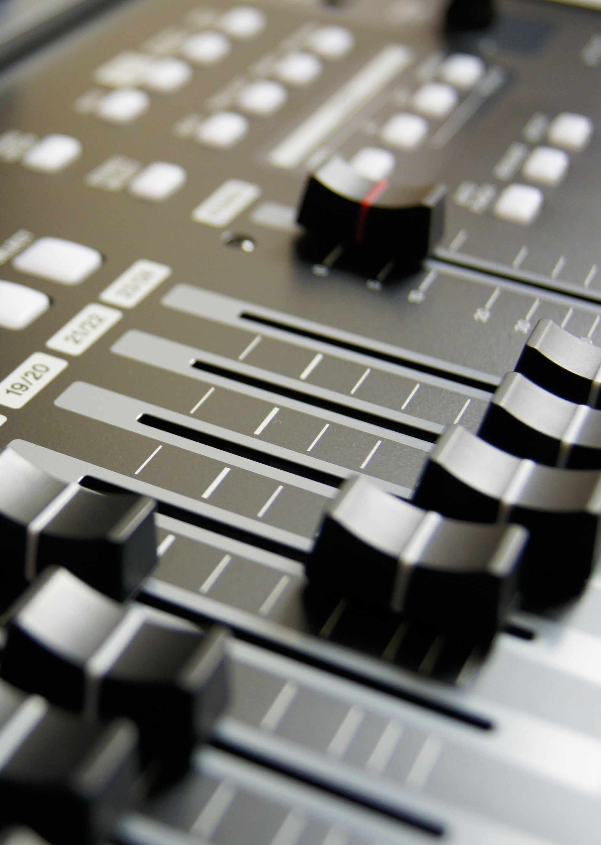
OUTLINE
Goal of the project
System description
System functioning
Profiling
Conclusion
Demo

Slide 3
Hardware-related goals
Dual-core
Hardware acceleration using DMA
Optional functionality
Custom instruction
C instruction

Slide 4
User-interface goals
Switch 0: record audio
Switch 1: Play processed audio
Switch 7: Volume up or down

Slide 5
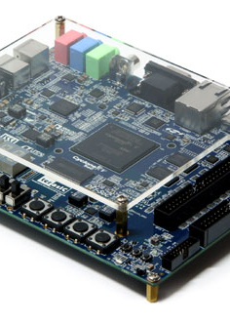
OUTLINE
Goal of the project
System description
System functioning
Profiling
Conclusion
Demo

Slide 6
System overview

Slide 7
Audio subsystem

Slide 8
Signal processing subsystem

Slide 9
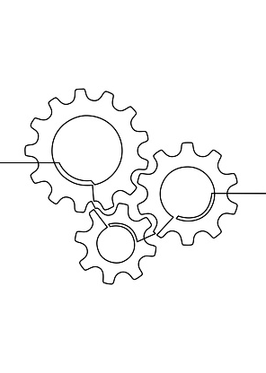
OUTLINE
Goal of the project
System description
System functioning
Profiling
Conclusion
Demo

Slide 10
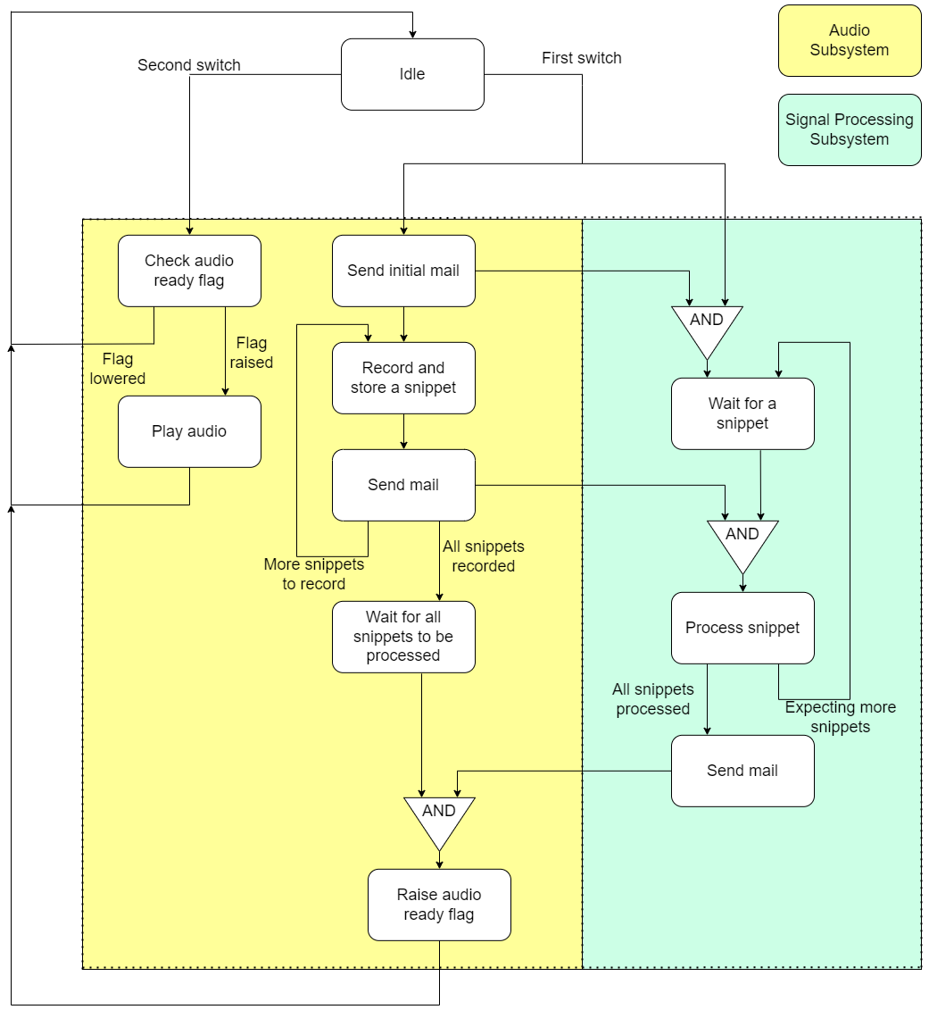
Workflow

Slide 11

OUTLINE
Goal of the project
System description
System functioning
Profiling
Conclusion
Demo

Slide 12
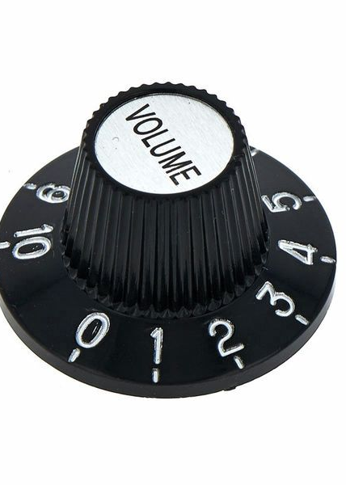
OUTLINE
Goal of the project
System description
System functioning
Profiling
Conclusion
Demo

Slide 13
OUTLINE
Goal of the project
System description
System functioning
Profiling
Conclusion
Demo

Slide 14
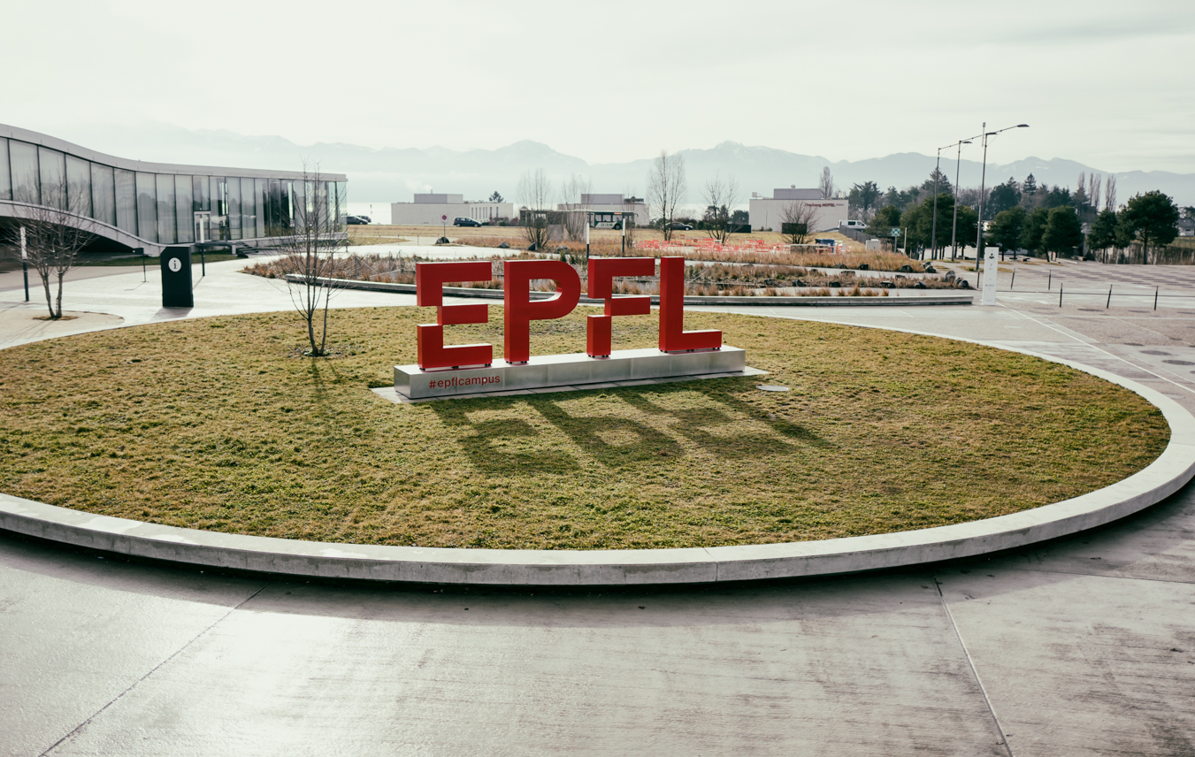
Thank you
Elias De Smijter
Erik Wilhelm Widlund Mellergård

